Slide 1

Getting started
Dara Renton (she/her)
Assistant Director @ the Ontario Digital Service

Slide 2
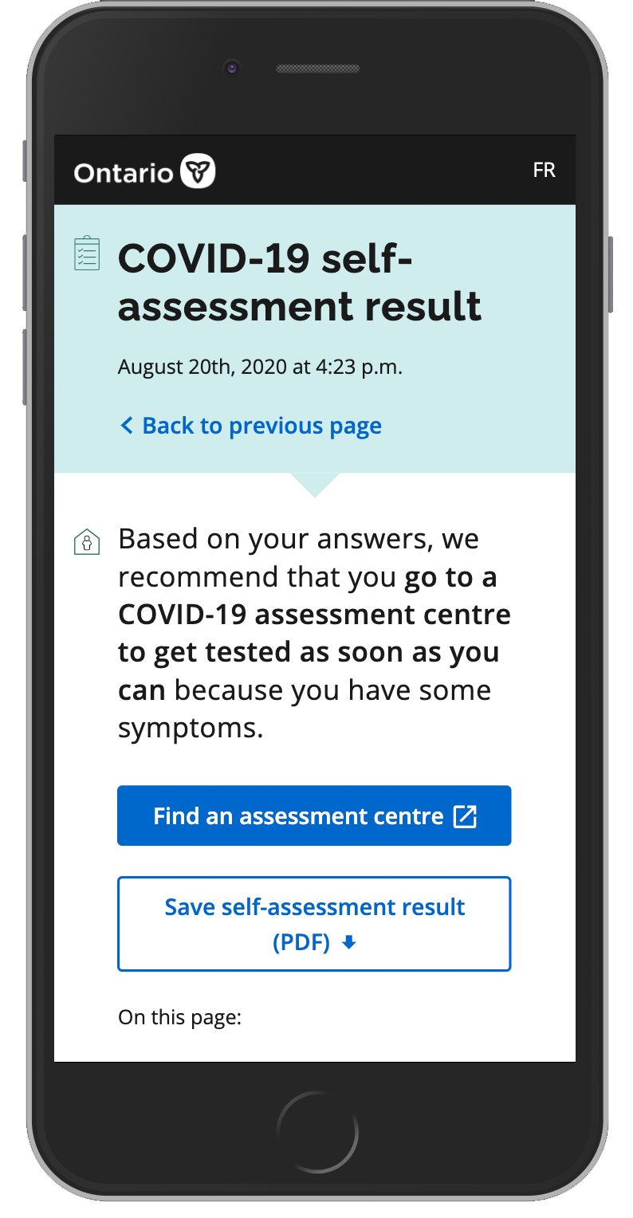
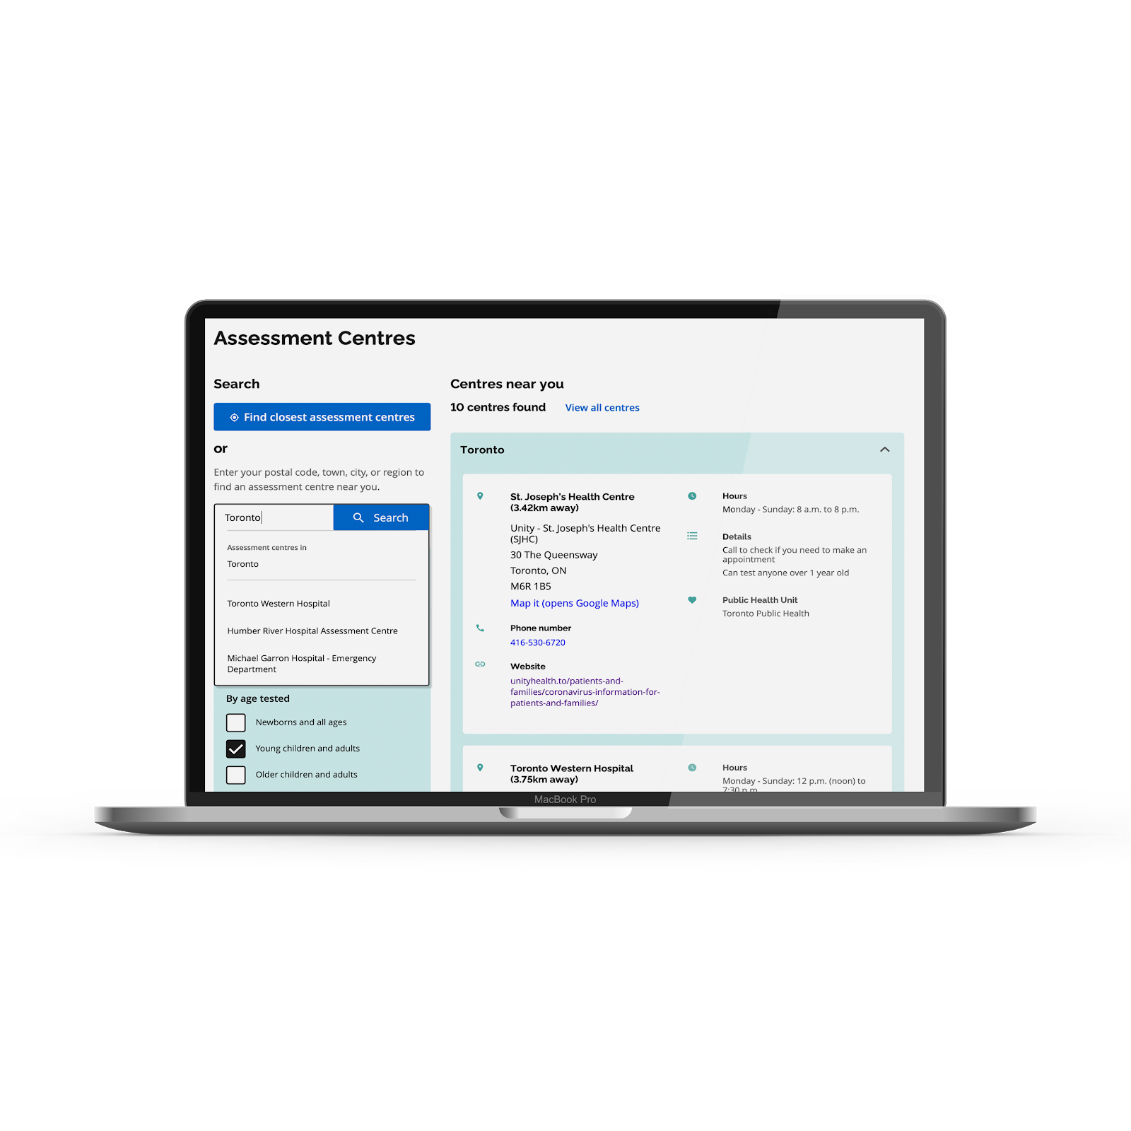
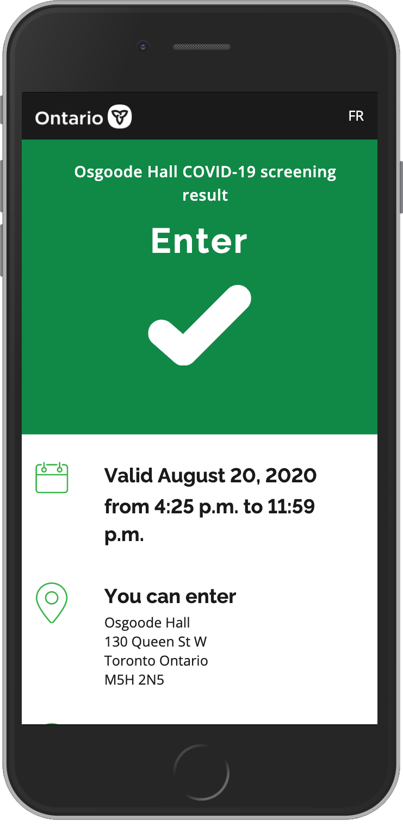
Ontario Digital Service: Product vision
Create a consistent, seamless end-to-end experience that:
Provides accurate, easy-to-understand information
Builds trust with government services
Drives needed behaviours or actions

Slide 3
Small, multi-disciplinary teams, designed to support agile methods and faster delivery, who have end-to-end responsibility for a product or service, and work together to deliver on user needs

Slide 4
The core team is small, multi-disciplinary and empowered to make decisions and iterate the product freely; this team works full time on the product.
The extended team consists of all touchpoints the team will need to deliver the product
The steering team is updated regularly, show-and-tells and provides course correction as required
CORE
TEAM
EXTENDED
TEAM
STEERING
TEAM

Slide 5
Content
Product team
Developers
Data
Web editor
Experience Design
Interaction design
Policy
Policy
Product Manager
User research
Product
Agile scrum master
Technology

Slide 6
Content Design
Web editor
QA
Content
Data Analyst
Web Analytics
Open Data
Data
Service Design
User Research
Interaction Design
Visual Design
Experience Design
Policy Advisor
Privacy Specialist
Policy
Product Manager
Agile Scrum Master
Product
Front-end Developer
Back-end Developer
Full stack Developer
Specialized Developer
DevOps
Technology

Slide 7
Assessment Tools
COVID-19 Website
Product manager
Product manager
Designer
Designer
Content Advisor
Content Advisor
Core Team
Full Stack Dev
Full Stack Dev
Front-end Dev
Full Stack Dev
Back-end Dev
Data Analyst
User Research
+Ministry partners
+Policy
+Communications
Extended Team
Web analytics
QA
DevOps

Slide 8
A minimum viable product is a version of a product with just enough features to be usable by early customers who can then provide feedback for future product development.
Credit: Wikipedia

Slide 9
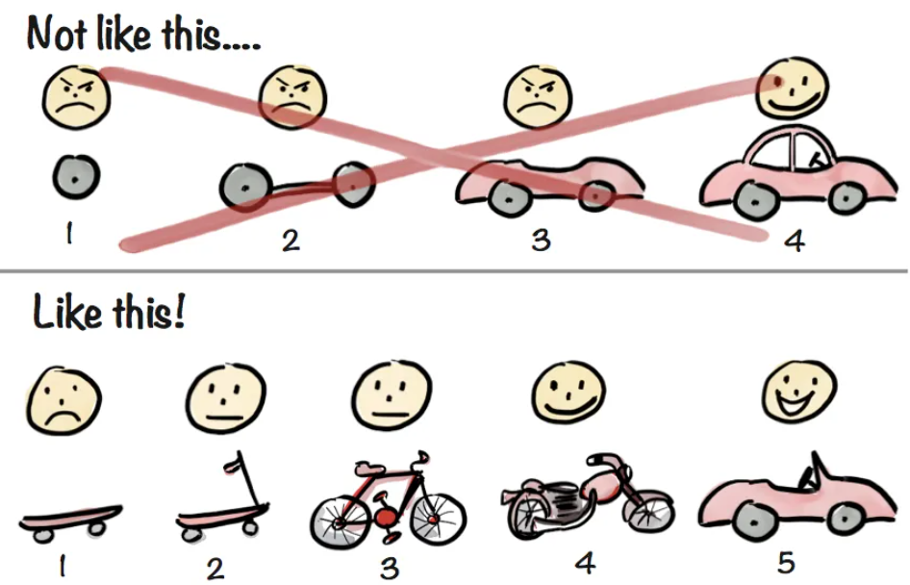
Credit: Henrik Kniberg

Slide 10
Just how minimum is viable?

Slide 11
User need
Constraints
Opportunity
Credit: ODS Slack, #c-product

Slide 12
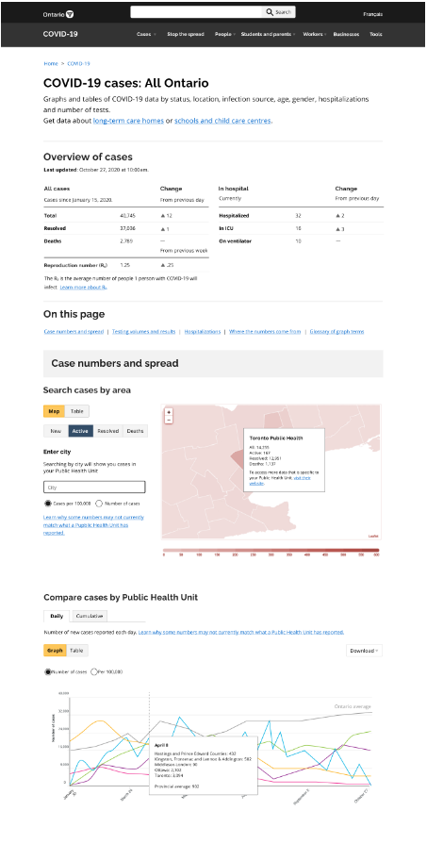
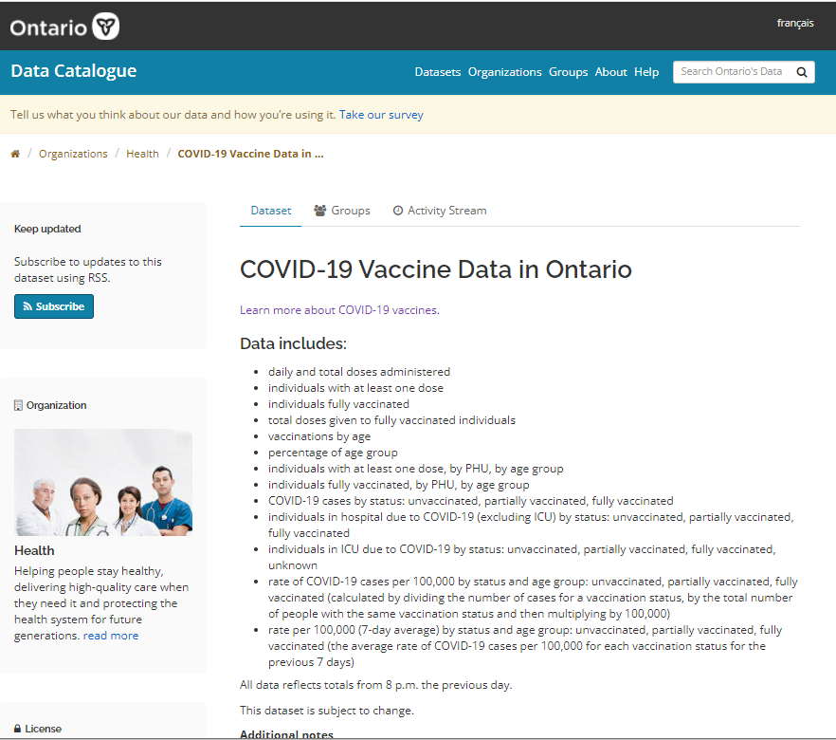

Slide 13

Thank you!
Contact: dara.renton@ontario.ca
Twitter: @drenton
Visit:
ontario.ca/digital
https://covid-19.ontario.ca/covid-19-guidance-tools

